Slide 1
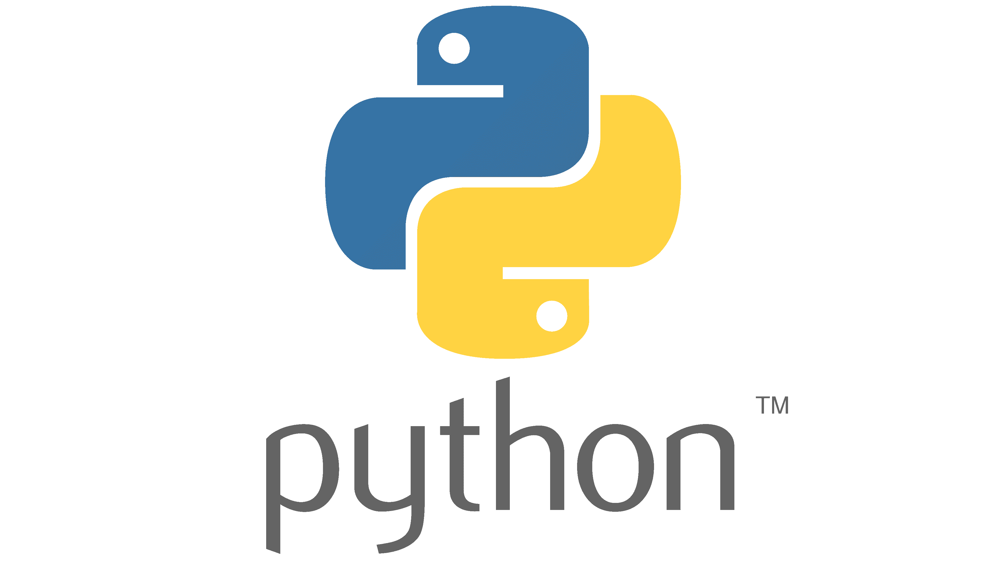
By
Divya Premkumar Patil
Libity Infotech

Slide 2
Day 2 Content
Python Syntax
Keywords
Identifiers
Naming Conventions
Python Quotations
Python Statements
Indentations
Comments
Single Line Comments
Multiline Comments
Programs on all of above

Slide 3
Python Syntax
Python syntax refers to the set of rules that defines how human users and the system should write and interpret a python program.

Slide 4
Keywords
Python keywords are reserved words in python, that should not be used as variables, constants, function name or identifier in your code

Slide 5
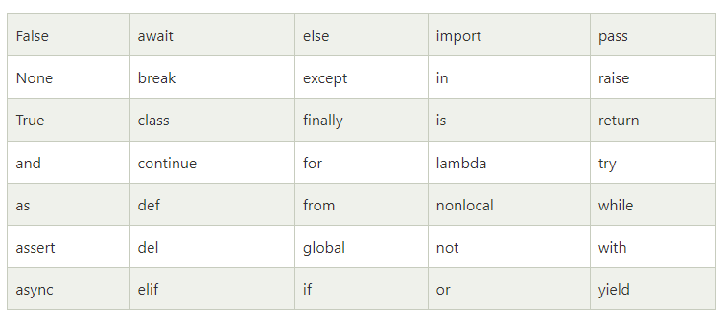
List of Keywords

Slide 6
Python Identifiers
A python identifier is a name given to a function, class, variable, module, or other objects that you will be using in your python program.
Any entity you’ll be using in python should be appropriately named or identified as they will form part of your program.

Slide 7
Python naming conventions
An identifier can be a combination of uppercase letters, lower case letters, underscores and digits(0-9). Hence the following are valid identifiers:
myClass, my_variable, var_1 and print_hello_world
Special characters such as %, @, #, and $ are not allowed within identifiers.
An identifier should not begin with a number. Hence 2variable is not valid but variable2 is acceptable.

Slide 8
Python is a case sensitive language and this behaviour extends to identifiers. e.g. Thus Labour & labour are two distinct identifiers in python.
You cannot use Python keywords as Identifiers.
Class identifiers begin with an uppercase letter, but the rest of the identifiers begin in lowercase.
You can use Underscores to separate multiple words in your identifier
You should always choose identifiers that will make sense to you even after a long gap.

Slide 9
Hence, while it is easy to set your variable to c=2, you might find it more useful/helpful for future reference if you use a longer but more relevant variable name such as count= 2.

Slide 10
Python Quotations
Python allows the use of quotation marks to indicate string literals.
You can use single, Double Or tripple quotes but you must start and end the string with the same type.

Slide 11
Python Statements
Statements are instructions that a python interpreter can execute
When you assign a value to a variable, say my_variable= “divya”, you are making an assignment statement.
An assignment statement can be as short as c= 3

Slide 12
Indentation
While most programming languages such as C, C++ and JAVA uses curly braces to denote block of code, python programs are structured through indentation
In python, block of codes are defined by indentation,not as a matter of style or preference but as a rigid language requirement.
This principle makes python code more readable and understandable.
A block of code can be easily identified when you look at a python program as they start on the same distance to the right.

Slide 13
Indentation refers to the spaces at the beginning of a code line.
Ex: if 5>2:
print(“Five is greater than two!”)
Python will give you an error if you skip the indentation
Ex: if 5>2:
print(“Five is greater than two!”)

Slide 14
Comments
When writing a program, you'll find it helpful to put some notes within your code to describe what it does.
A comment is very handy when you have to review or revisit your program.
It will also help anotherprogrammerwho might need to go over the source code.

Slide 15
Single line comment
You can write comments within your program by starting the line with a hash(#) symbol.
A hash symbol tells the python interpreter to ignore the comment when running our code.
Ex: # This is a single line comment
#print("Hello World")
Comments can be placed at the end of a line & python will ignore the rest of the line.
Ex: print("Hello World!") #This is a comment

Slide 16
Comments does not have to be ued only to explain the code, it can also be used to prevent python from executing code.
Ex: #print("Hello World")
print("Cheers, Mate!")
output:- Cheers, Mate!

Slide 17
Multiline comments
You can use a hash symbol t the beginning of each line
Alternative, you can also wrap multiline comment with triple quotes ""“ ""“
Ex: #This is a comment
#wriiten in
#more than just one line
print("Hello World!")
output:- Hello World!

Slide 18
Or you can add a multiline string within (tripple quotes) in your code & place your coment inide it:
Ex: """This is a comment
wriiten in
more than just one line
print("Hello World!")"""
output:- Hello World!

Slide 19


